Slide 1
CPE 133
Review
Illegal State Recovery
Design Example
Experiment 9

Slide 2
General FSM Model

Slide 3
Design Example #9
Using the diagram on the right, design a FSM that implements a synchronous counter that has both a 2-bit binary (BCNT) and a 3-bit stoneage binary (SBCNT) output. The FSM also a count enable input (CE) which serves two functions. When the CE is asserted, both counter outputs increment of the active clock edge. When CE is not asserted, the neither count is incremented. Additionally, the binary count (BCNT) outputs “00” when CE is not asserted, but returns to its original value when CE is reasserted. The SBCNT output does not increment, but does not go to zero when the CE input is not asserted.
Provide a circuit diagram
Provide a state diagram

Slide 4
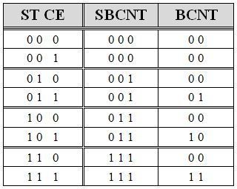
Design #9: Solutions
State Diagram
Circuit Design
Output Decoder Design #9

Slide 5
Design #9: Timing Diagram
BCNT: Mealy-type Output: based on state & external input (CE)
SBCNT: Moore-type Output: based on state only

Slide 6
FSM Output Types
Moore Outputs
Only a function of FSM state
Mealy Outputs
Function of FSM state & External Input(s)

Slide 7
Counter Example
Counter State Diagram: sequence = …6,0,5,7,3,6,0,5…

Slide 8
Illegal State Recovery
FSMs can have unused state
When number of states is not a power of two
What happens when FSM finds itself in an unused state?
FSM could “hang”
Counter State Diagram: sequence = …6,0,5,7,3,6,0,5…

Slide 9
Hang States
What you want
What you might get
How to “fix it”

Slide 10
Design Example:
Design a counter that repeatedly counts in the following sequence: {4, 18, 20, 30, 8}. The circuit has a HOLD input that stops the counter from counting while asserted. When the HOLD input is asserted, the count output is halved. Make the circuit self-correcting by directing all unused states to count = 4. Outputs associated with unused states should be all 1’s.
Minimize the amount of memory in circuit
Provide a circuit diagram
Provide a state diagram

Slide 11
Experiment #9: 4-Bit Up/Down Counter with Multiplexed 7-Segment Display
Modification of Experiment #8
Outputs
Stoneage binary
Mealy – based on state & direction input
4-bit unsigned binary
Moore – based on state only
Write your own two-digit display multiplexor
Don’t use univ_sseg.v
Requires two clock dividers
If in doubt, think decoders…

Slide 12
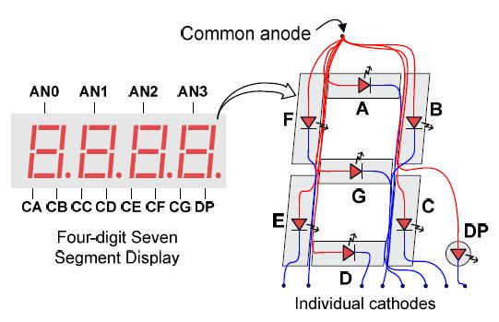
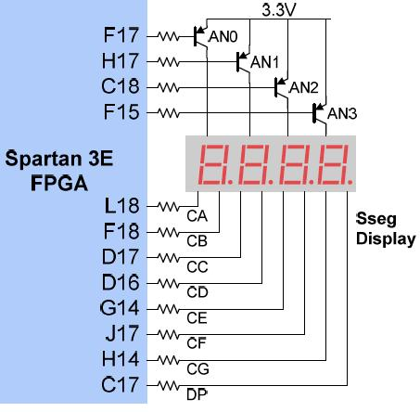
Common Anode Configuration
Only displays one unique number at a time

